Slide 1
PowerPoint template to accompany the Black History Month 2019 lesson pack for:
Year 1 and 2 – England and Wales
P2 and P3 – Scotland
We know that good teaching is tailored to meet the needs of the children or young people in each individual class. That’s why we’ve created this editable PowerPoint template – feel free to adapt it to suit your teaching context or to add your school or college slide template to the background.
Who are Stonewall?
This resource is produced by Stonewall, a UK-based charity that stands for the freedom, equity and potential of all lesbian, gay, bi, trans, queer, questioning and ace (LGBTQ+) people. At Stonewall, we imagine a world where LGBTQ+ people everywhere can live our lives to the full. Founded in London in 1989, we now work in each nation of the UK and have established partnerships across the globe. Over the last three decades, we have created transformative change in the lives of LGBTQ+ people in the UK, helping win equal rights around marriage, having children and inclusive education.
Our campaigns drive positive change for our communities, and our sustained change and empowerment programmes ensure that LGBTQ+ people can thrive throughout our lives. We make sure that the world hears and learns from our communities, and our work is grounded in evidence and expertise.
Stonewall is proud to provide information, support and guidance on LGBTQ+ inclusion; working towards a world where we’re all free to be. This does not constitute legal advice, and is not intended to be a substitute for legal counsel on any subject matter. To find out more about our work, visit us at www.stonewall.org.uk.
Registered Charity No 1101255 (England and Wales) and SC039681 (Scotland)
Notes:
Visit our website for the lesson plan to accompany this PowerPoint.

Slide 2
LO: To explain why it is important to treat people fairly

Slide 3
Before we start….
Our rules
Notes:
Discuss ground rules for the lesson: listening to each other, taking turns to speak, being kind, respecting other people.

Slide 4
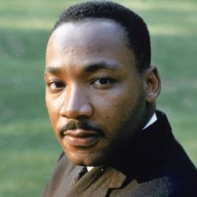
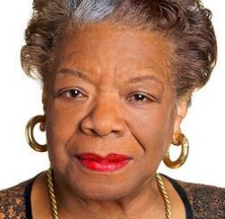
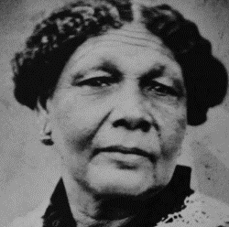
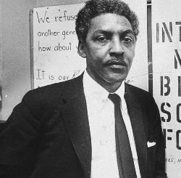
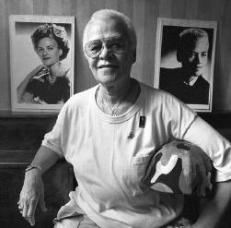
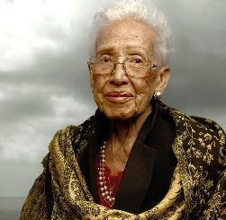
LO: To explain why it is important to treat people fairly
Black History Month
A time to celebrate black people from history (even more than usual)!
Notes:
Explain that Black History Month is a time where we celebrate black people’s contributions to our history. It’s important to do this because black people are often forgotten about in history.

Slide 5
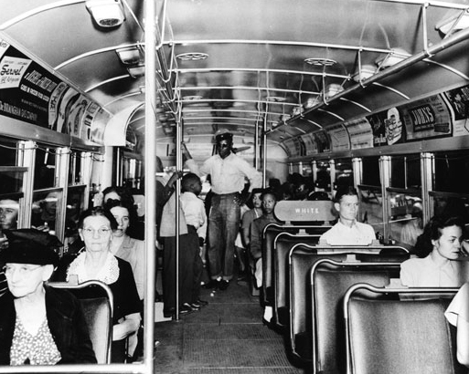
LO: To explain why it is important to treat people fairly
Can you see what’s wrong in this photo?
Notes:
Explain that today we’re going to learn about some important black people from history. In the past, black people were treated unfairly in America – they had to use separate water fountains, go to separate schools and sit at the back of the bus. The people we are going to learn about helped bring about a change.

Slide 6
LO: To explain why it is important to treat people fairly
Jigsaw challenge!
Notes:
Jigsaw challenge: Give each group a Black role models jigsaw (Rosa Parks, Martin Luther King Jr, Bayard Rustin. Challenge the groups to race to complete the jigsaw.

Slide 7
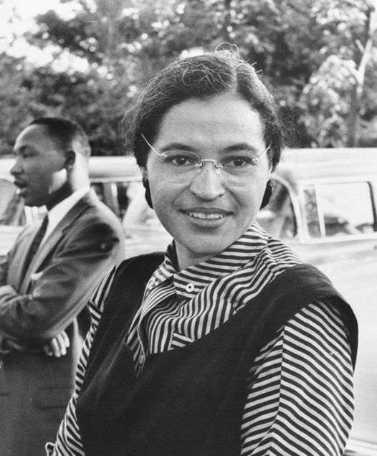
LO: To explain why it is important to treat people fairly
Rosa Parks
Notes:
Show the picture of Rosa Parks. Ask children to put their hands up if they’d completed the picture of Rosa.

Slide 8
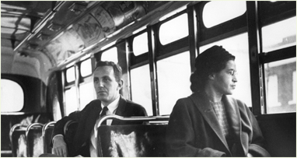
LO: To explain why it is important to treat people fairly
Rosa Parks protested against unfair treatment.
She did not sit at the back of the bus.
Notes:
Explain that Rosa Parks made a stand by saying that she would not sit at the back of the bus. Rosa helped to inspire others to protest against unfair treatment.

Slide 9
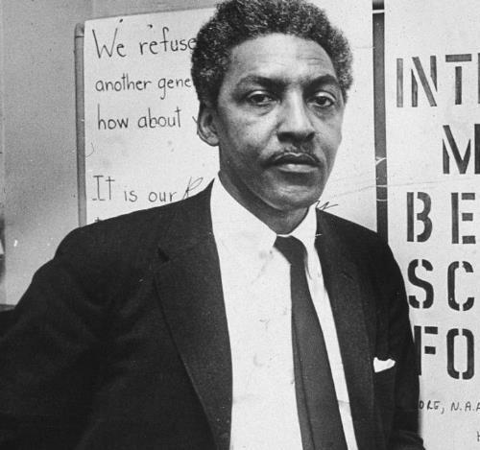
LO: To explain why it is important to treat people fairly
Bayard Rustin
Notes:
Show the picture of Bayard Rustin. Ask children to put their hands up if they’d completed the picture of Bayard.

Slide 10
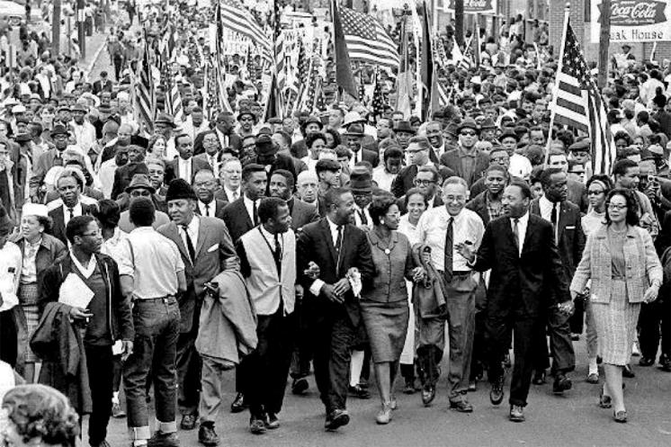
LO: To explain why it is important to treat people fairly
Bayard Rustin organized events and helped people speak out against being treated unfairly.
Notes:
Explain that Bayard helped to organize events that brought people together to protest against unfair treatment – a bus boycott, protest marches and a big rally in Washington DC, the capital of USA.

Slide 11
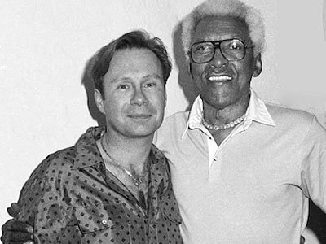
LO: To explain why it is important to treat people fairly
Bayard Rustin was treated unfairly because he was black and because he had a boyfriend.
Notes:
Explain that Bayard was gay. Because he had a boyfriend, he was treated even less fairly than other black people.

Slide 12
LO: To explain why it is important to treat people fairly
How would it feel to be treated unfairly because of the colour of your skin?
How would it feel to be treated unfairly because of who you fall in love with?
Notes:
Ask: How might it feel to be treated unfairly because of the colour of your skin or because of who you fall in love with?

Slide 13
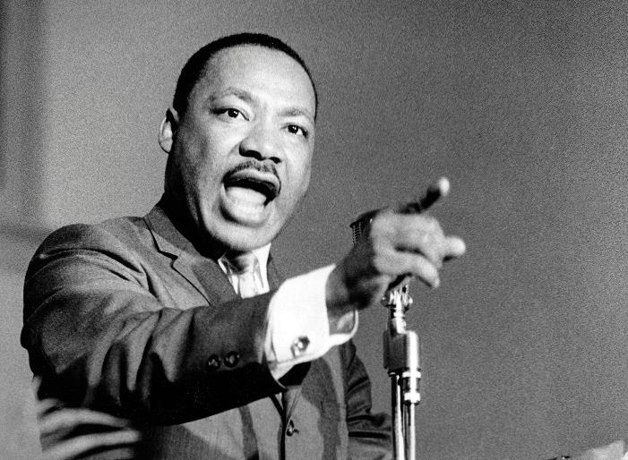
LO: To explain why it is important to treat people fairly
Martin Luther King Jr
Notes:
Show the picture of Martin Luther King Jr. Ask children to put up their hands if they’d completed the picture of Martin.

Slide 14
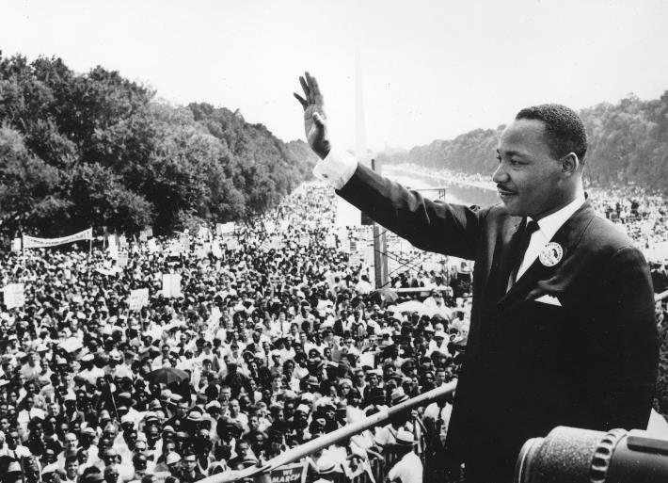
LO: To explain why it is important to treat people fairly
Martin Luther King Jr is famous for his speeches.
He spoke about the way that black people were unfairly treated.
Notes:
Explain that Martin was famous for his inspirational speeches at the events that Bayard had organized. His most famous speech is ‘I have a dream’, where he asked for black people in USA to be treated fairly.

Slide 15
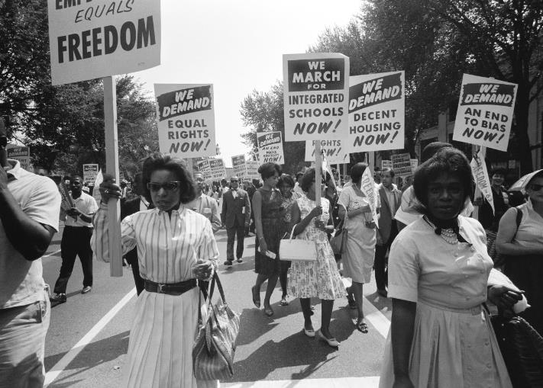
LO: To explain why it is important to treat people fairly
Make your own placard.
It must show why we should treat people fairly.
Notes:
Ask: Why do we need to treat people fairly? Think. Pair. Share.
Children create their own placards to remind people that it’s important to treat other people fairly.
Once the placards are ready, go on a ‘fairness march’ around the playground, waving your placards.

