Slide 1
PowerPoint template to accompany the Black History Month 2019 lesson pack for:
Key Stage 3 – England and Wales
S1 to S3 - Scotland
We know that good teaching is tailored to meet the needs of the children or young people in each individual class. That’s why we’ve created this editable PowerPoint template – feel free to adapt it to suit your teaching context or to add your school or college slide template to the background.
Who are Stonewall?
This resource is produced by Stonewall, a UK-based charity that stands for the freedom, equity and potential of all lesbian, gay, bi, trans, queer, questioning and ace (LGBTQ+) people. At Stonewall, we imagine a world where LGBTQ+ people everywhere can live our lives to the full. Founded in London in 1989, we now work in each nation of the UK and have established partnerships across the globe. Over the last three decades, we have created transformative change in the lives of LGBTQ+ people in the UK, helping win equal rights around marriage, having children and inclusive education.
Our campaigns drive positive change for our communities, and our sustained change and empowerment programmes ensure that LGBTQ+ people can thrive throughout our lives. We make sure that the world hears and learns from our communities, and our work is grounded in evidence and expertise.
Stonewall is proud to provide information, support and guidance on LGBTQ+ inclusion; working towards a world where we’re all free to be. This does not constitute legal advice, and is not intended to be a substitute for legal counsel on any subject matter. To find out more about our work, visit us at www.stonewall.org.uk.
Registered Charity No 1101255 (England and Wales) and SC039681 (Scotland)
Notes:
Visit our website for the lesson pack to accompany this PowerPoint.

Slide 2
LO: To understand how the Black LGBT community has contributed to history
Notes:
Create a list of ground rules as a class i.e respecting identities and opinions - this may also include no judgement, not speaking over each other and being honest with any and all questions we have.
Start with a class discussion on BHM and the form is has taken in the past.
What does BHM mean to the students? Why is BHM marked in calendars? Why is it significant? Highlight that historically racism and racist discrimination meant that black people were held back from accessing the same opportunities as white people – and also the many achievements and contributions to history of the black community were not talked about, highlighted or celebrated as much as they should have been (and sometimes not talked about at all). We’ve made progress today but black people are still underrepresented in lots of areas, including the media, politics and leadership, and racism and racist discrimination against black people still happens far too often – so it’s important that we go on having these conversations.
Whose stories have been missing from the conversation during BHM?
If students don’t bring up LGBT role models, direct them towards it.

Slide 3
LO: To understand how the Black LGBT community has contributed to history
How many role models can you think of?
Notes:
Hand out the LGBT Black Role Models worksheet. Ask students to complete the table with as many LGBT black role models as they can think of in their groups/tables

Slide 4
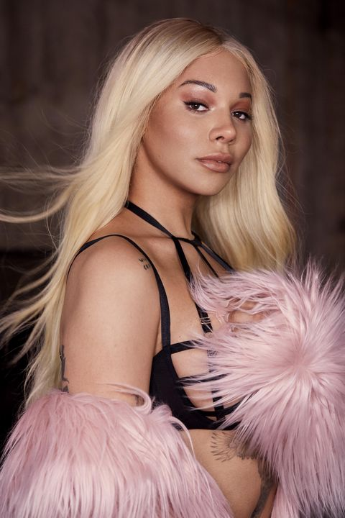
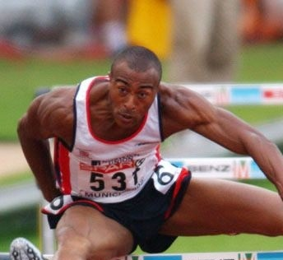
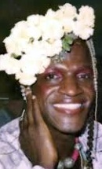
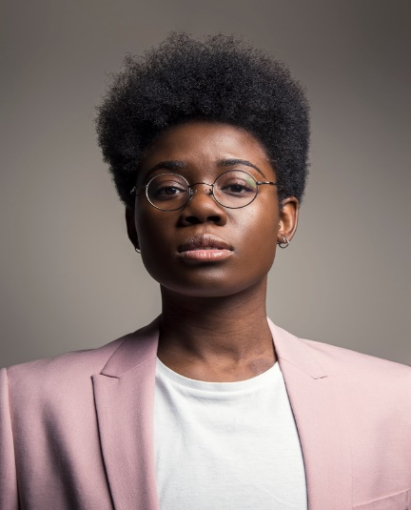
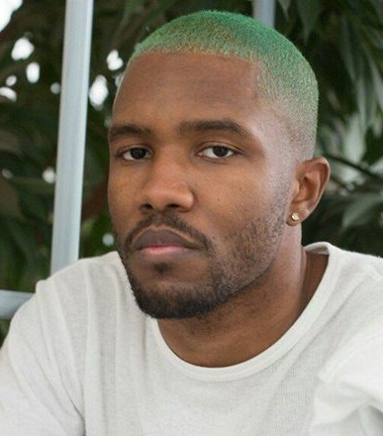
LO: To understand how the Black LGBT community has contributed to history
Notes:
Show students different role models on the board (Bayard Rustin – Civil Rights Leader, Dr Ronx – Emergency medical doctor , Marsha P Johnson – Stonewall Rioter, Munroe Bergdorf – Model, Janelle Monae – Singer/Songwriter, Frank Ocean – Singer/Songwriter)
Ask: What have these people got in common? Think. Pair. Share.
Ask: What else might these people have in common? Think. Pair. Share.
Ask: Why do you think these people are role models? Think,. Pair. Share.

Slide 5
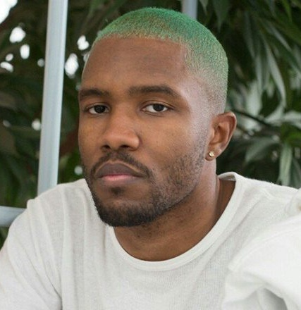
LO: To understand how the Black LGBT community has contributed to history
Janelle Monae is an American singer/songwriter. She came out as pansexual on the cover of rolling stone in 2018.
Munroe Bergdorf is a model and activist who has walked runways at NYC and London. She is also trans.
Frank Ocean is an American singer, songwriter, rapper, record producer, and photographer. Frank Ocean came out as bi on Tumblr.
Notes:
Share the additional information about each person and discuss that they are all LGBT.

Slide 6
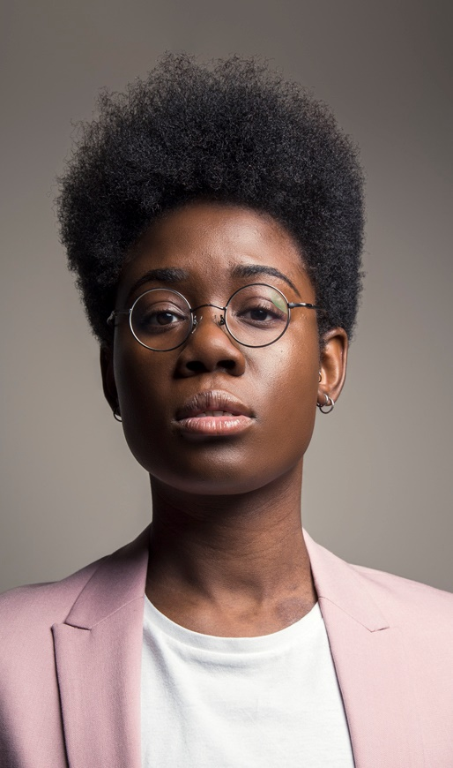
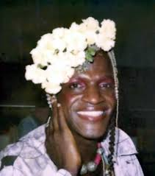
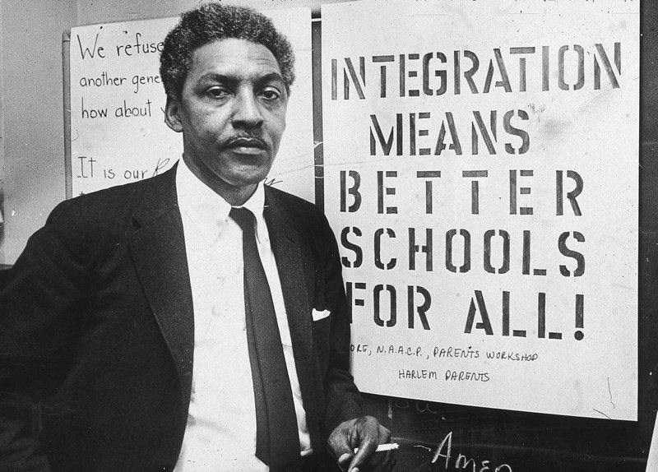
LO: To understand how the Black LGBT community has contributed to history
Dr Ronx is an Emergency medicine doctor by profession. They describe themself as a queer, black, androgynous intersectional feminist.
Marsh P Johnson was a prominent figure of the Stonewall Riots in 1969 and gay rights activist. She was also trans.
Bayard Rustin was a prominent American civil rights leader. He was a pivotal part of the March on Washington. He was also gay.
Notes:
Share the additional information about each person and discuss that they are all LGBT.

Slide 7
LO: To understand how the Black LGBT community has contributed to history
Create a poster on the most inspiring Black LGBT role model for Black History Month awareness
Notes:
Ask the students to choose a role model who inspires them the most. They should then create a poster about them.
It is a poster that they are creating for BHM awareness.
They should consider that the audience will be other students from your school.

Slide 8
LO: To understand how the Black LGBT community has contributed to history
Quiz
Notes:
Complete the BHM LGBT role models quiz. Either in groups or as individuals.

