Slide 1
PowerPoint template to accompany the My Family RSHE lesson pack for:
Year 1 and 2 – England and Wales
P2 and P3 - Scotland
We know that good teaching is tailored to meet the needs of the children or young people in each individual class. That’s why we’ve created this editable PowerPoint template – feel free to adapt it to suit your teaching context or to add your school or college slide template to the background.
Who are Stonewall?
This resource is produced by Stonewall, a UK-based charity that stands for the freedom, equity and potential of all lesbian, gay, bi, trans, queer, questioning and ace (LGBTQ+) people. At Stonewall, we imagine a world where LGBTQ+ people everywhere can live our lives to the full. Founded in London in 1989, we now work in each nation of the UK and have established partnerships across the globe. Over the last three decades, we have created transformative change in the lives of LGBTQ+ people in the UK, helping win equal rights around marriage, having children and inclusive education.
Our campaigns drive positive change for our communities, and our sustained change and empowerment programmes ensure that LGBTQ+ people can thrive throughout our lives. We make sure that the world hears and learns from our communities, and our work is grounded in evidence and expertise.
Stonewall is proud to provide information, support and guidance on LGBTQ+ inclusion; working towards a world where we’re all free to be. This does not constitute legal advice, and is not intended to be a substitute for legal counsel on any subject matter. To find out more about our work, visit us at www.stonewall.org.uk.
Registered Charity No 1101255 (England and Wales) and SC039681 (Scotland)
Notes:
Visit our website for the lesson plan to accompany this PowerPoint.

Slide 2
LO: To be able to talk about my family
Notes:
As a class, read The Family Book by Todd Parr. Discuss the different types of family, including families with same sex parents, foster families and adoptive families

Slide 3
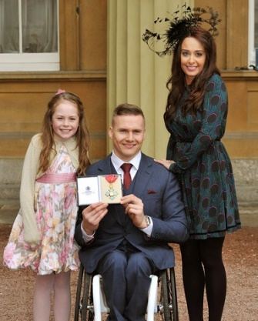
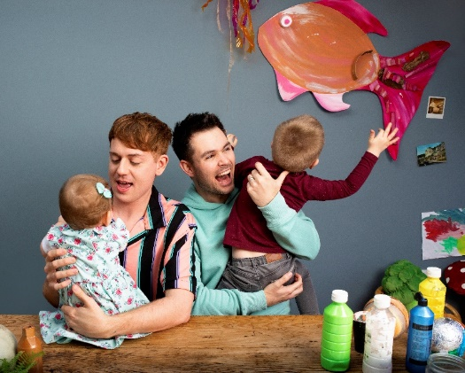
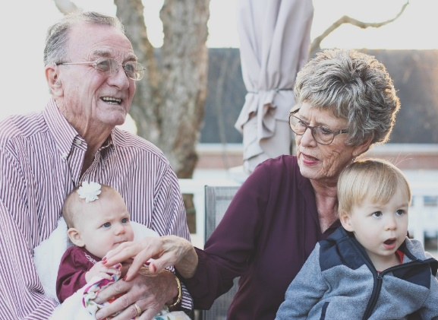
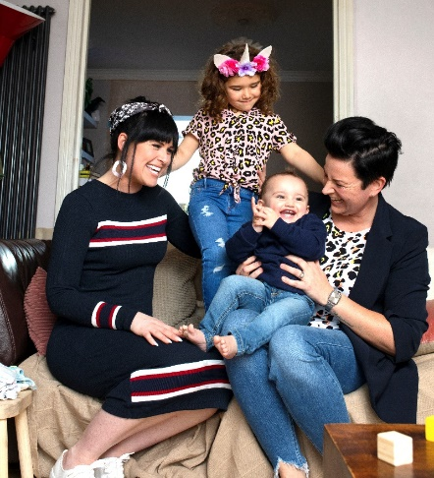
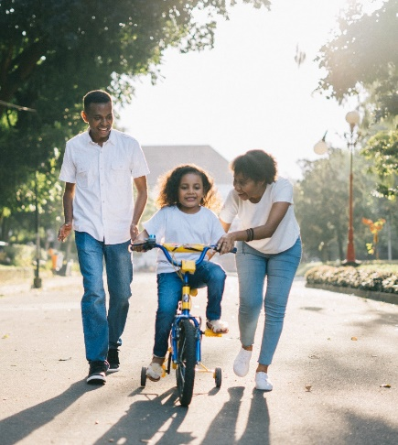
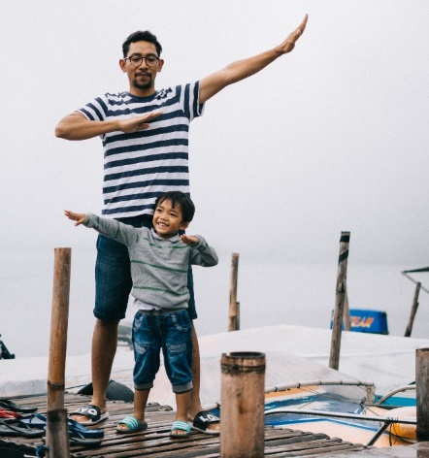
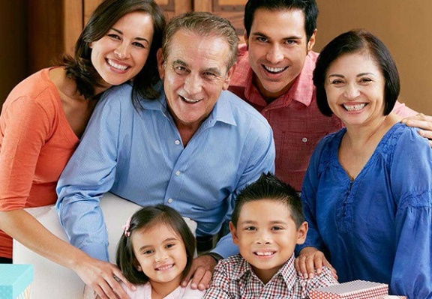
LO: To be able to talk about my family
Who is in these families?
Notes:
Who are the people in these different families?

Slide 4
LO: To be able to talk about my family
How are these families similar to your family?
Notes:
Ask children to discuss how each family is similar to and different from their family.

Slide 5
LO: To be able to talk about my family
How are these families different from your family?
Notes:
Ask children to discuss how each family is similar to and different from their family.

Slide 6
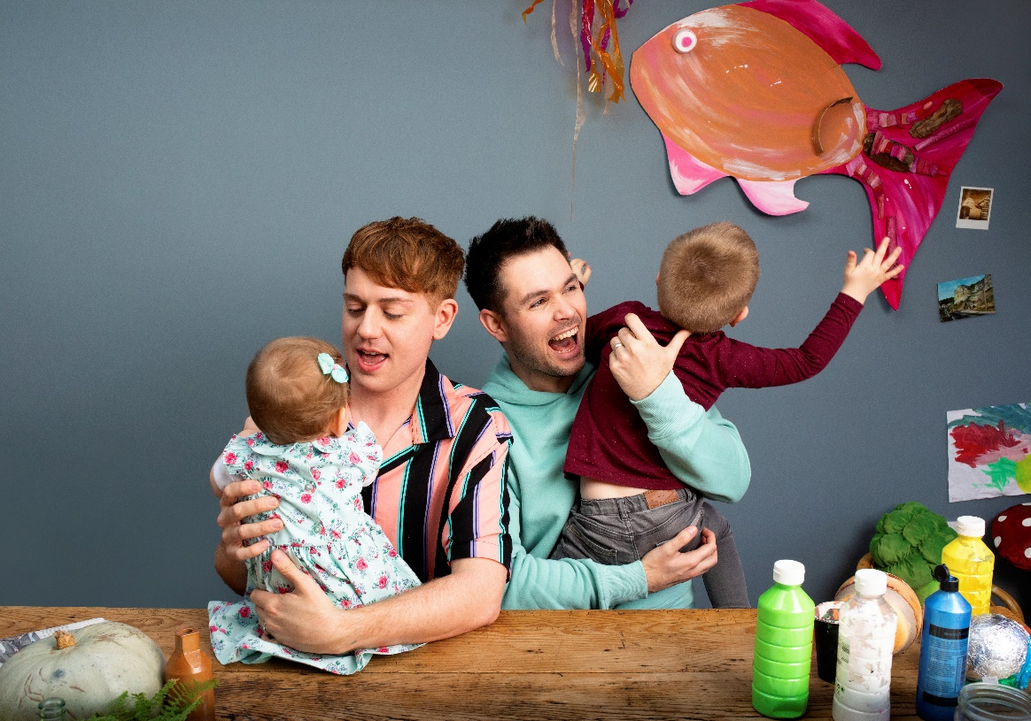
LO: To be able to talk about my family
Some families like to paint at their kitchen table.

Slide 7
LO: To be able to talk about my family
Some families go to the cinema.

Slide 8
LO: To be able to talk about my family
Some families visit the Queen at Buckingham Palace.

Slide 9
LO: To be able to talk about my family
Some families like sailing.

Slide 10
LO: To be able to talk about my family
What do you like to do with your family?

Slide 11
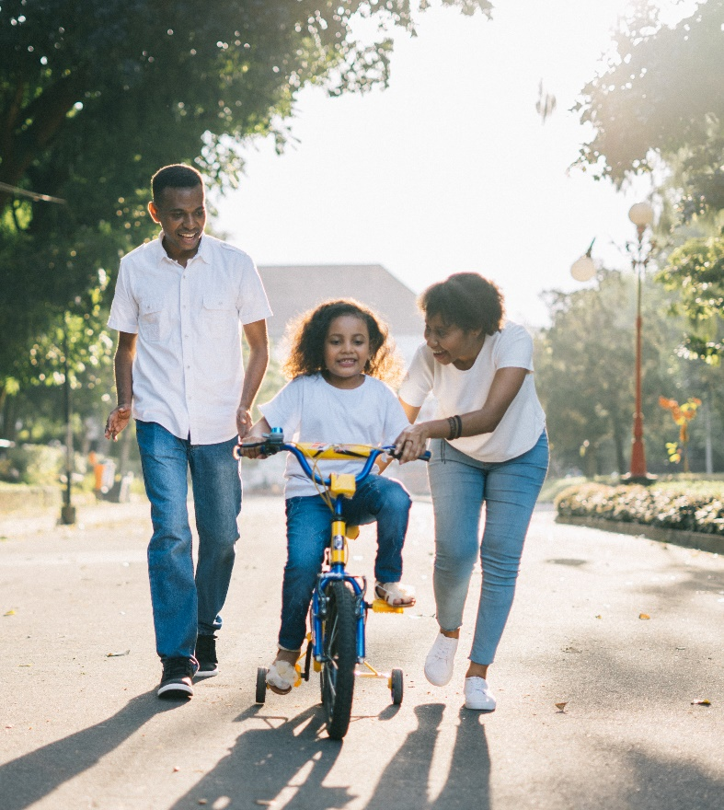
LO: To be able to talk about my family
Make a family portrait
Draw your family doing an activity that you do together.
Write a caption for your family portrait.
Some families like...
Notes:
Children draw a picture of their family in the style of Todd Parr – a picture of their family doing an activity that they all enjoy. They should write a caption to accompany it – for example ‘Some families like to go camping’.

Slide 12
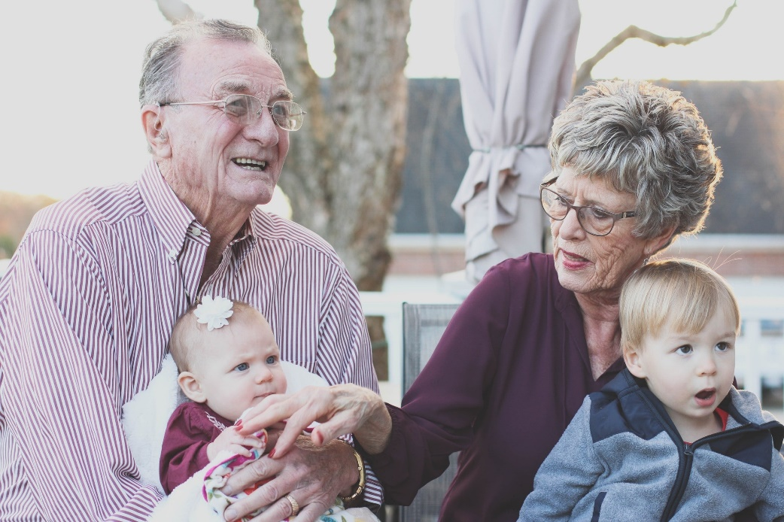
LO: To be able to talk about my family
How are families similar?
How are our families different
Notes:
Give children 5-10 minutes to look at each others’ family portraits. Ask them to look for ways in which other people’s family are similar to theirs and ways in which they are different.
Class discussion: How is your family similar to other people’s family? How is your family different?

