Slide 1
PowerPoint template to accompany the Black History Month 2020 lesson pack for:
Reception – England and Wales
P1 – Scotland
We know that good teaching is tailored to meet the needs of the children or young people in each individual class. That’s why we’ve created this editable PowerPoint template – feel free to adapt it to suit your teaching context or to add your school or college slide template to the background.
Who are Stonewall?
This resource is produced by Stonewall, a UK-based charity that stands for the freedom, equity and potential of all lesbian, gay, bi, trans, queer, questioning and ace (LGBTQ+) people. At Stonewall, we imagine a world where LGBTQ+ people everywhere can live our lives to the full. Founded in London in 1989, we now work in each nation of the UK and have established partnerships across the globe. Over the last three decades, we have created transformative change in the lives of LGBTQ+ people in the UK, helping win equal rights around marriage, having children and inclusive education.
Our campaigns drive positive change for our communities, and our sustained change and empowerment programmes ensure that LGBTQ+ people can thrive throughout our lives. We make sure that the world hears and learns from our communities, and our work is grounded in evidence and expertise.
Stonewall is proud to provide information, support and guidance on LGBTQ+ inclusion; working towards a world where we’re all free to be. This does not constitute legal advice, and is not intended to be a substitute for legal counsel on any subject matter. To find out more about our work, visit us at www.stonewall.org.uk.
Registered Charity No 1101255 (England and Wales) and SC039681 (Scotland)
Notes:
Visit our website for the lesson plan to accompany this PowerPoint.

Slide 2
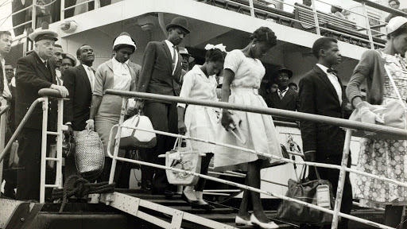
LO: To recall some information about Windrush

Slide 3
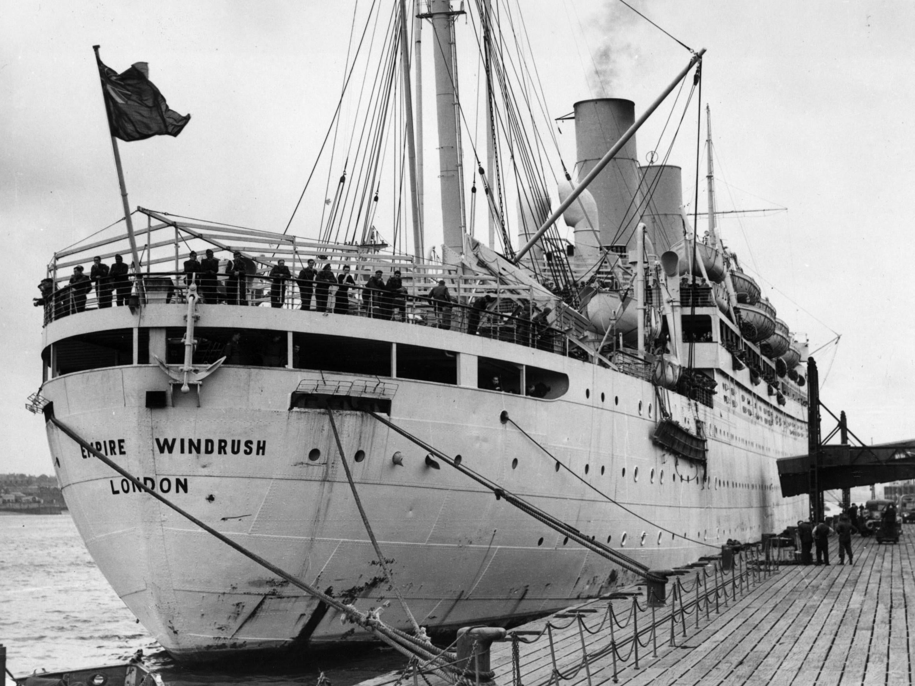
LO: To recall some information about Windrush
What was Windrush?
Notes:
Watch https://www.bbc.co.uk/newsround/43793769 https://www.bbc.co.uk/newsround/43793769
Class discussion:
How would it feel moving to a new country?
Have any of you moved to a new country? What was it like?
What sort of things might the people that came over on Windrush had to get used to? (eg weather, food).

Slide 4
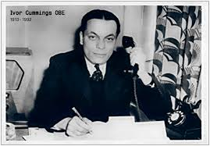
LO: To recall some information about Windrush
Ivor Cummings
Notes:
Explain that the person they will be learning about had an important part to play in helping the people that migrated on The Windrush.

Slide 5
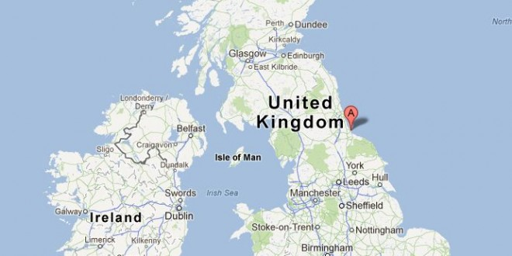
LO: To recall some information about Windrush
Born in Hartlepool in 1913

Slide 6
LO: To recall some information about Windrush
It was Ivor’s job to help people who had moved to Britain.
Notes:
He worked for the government to help people who had moved from different Caribbean and African Commonwealth countries.

Slide 7
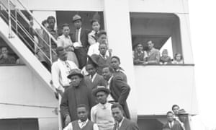
LO: To recall some information about Windrush
He went to the docks to meet the people that arrived on the Windrush.
Notes:
Ivor was in charge of organising housing and other arrangements for the 492 people that came over on a boat called the Empire Windrush and was there to meet them at Tilbury Docks

Slide 8
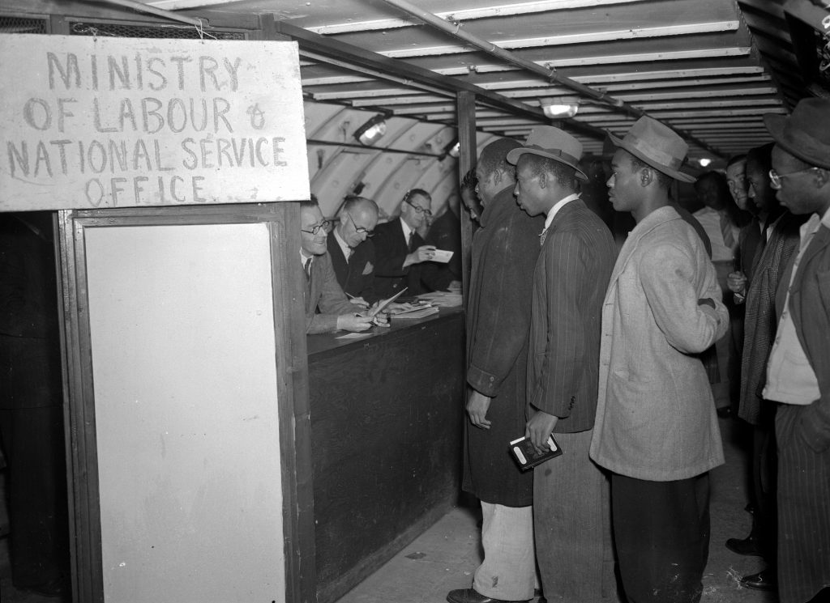
LO: To recall some information about Windrush
Ivor helped people to find jobs and somewhere to live.
Notes:
He worked for the government to help people who had moved from different Caribbean and African Commonwealth countries.

Slide 9
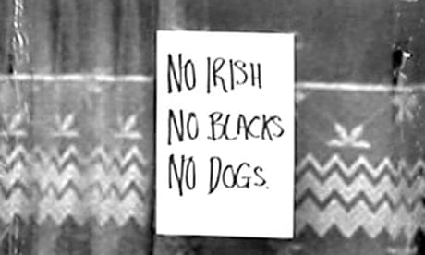
LO: To recall some information about Windrush
Black people were treated badly because of the colour of their skin.
This is called racism.
Notes:
Black people found it hard to find homes and jobs. They experienced racism and attacks. It was hard to settle in. Ivor He went over and above, helping people to find jobs and settle down in the UK. Ivor will also have experienced Racism

Slide 10
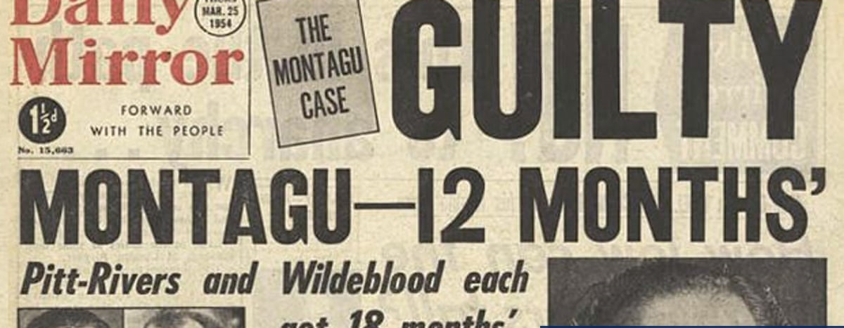
LO: To recall some information about Windrush
Ivor was gay and had boyfriends.
It was against
the law to be
gay in the
1950s.
Notes:
Help the children to understand that Ivor Cummings’ life would have been difficult at times. People would have treated him badly because he was gay and fell in love with other men. People will also have treated him badly because he was Black. Treating someone badly because of the colour of their skin is called racism. Lots of people that travelled to the UK on Windrush experienced racism. It made it harder for them to find somewhere to live and to get a job. This is why it was important that Ivor helped them.

Slide 11
LO: To recall some information about Windrush
How might it feel?
Notes:
How would it feel if someone treated you badly because of who you are or what you look like?
What should we do if we see someone being treated badly?
What should you do if someone treats you badly because of the colour of your skin, the people that are in your family, or anything else?

Slide 12
LO: To recall some information about Windrush
True or false?
True
False
Notes:
Read the following statements to check what children can remember about Ivor Cummings and Windrush. For true, children show thumbs up. For false, children show thumbs down.
Windrush was a boat. True
People travelled on the Windrush from Germany. False – the Windrush brought people from the Caribbean.
Ivor Cummings worked for the government. True – it was his job to help the people find jobs and places to live.
Ivor Cummings had a wife. False – Ivor was gay.
Black people were treated badly (and sadly often still are) because of the colour of their skin. True. Recap what children should do if they see someone being unkind to someone else.

