Slide 1
PowerPoint template to accompany the Families RSHE lesson pack for:
Year 3 and 4 – England and Wales
P4 and P5 - Scotland
We know that good teaching is tailored to meet the needs of the children or young people in each individual class. That’s why we’ve created this editable PowerPoint template – feel free to adapt it to suit your teaching context or to add your school or college slide template to the background.
Who are Stonewall?
This resource is produced by Stonewall, a UK-based charity that stands for the freedom, equity and potential of all lesbian, gay, bi, trans, queer, questioning and ace (LGBTQ+) people. At Stonewall, we imagine a world where LGBTQ+ people everywhere can live our lives to the full. Founded in London in 1989, we now work in each nation of the UK and have established partnerships across the globe. Over the last three decades, we have created transformative change in the lives of LGBTQ+ people in the UK, helping win equal rights around marriage, having children and inclusive education.
Our campaigns drive positive change for our communities, and our sustained change and empowerment programmes ensure that LGBTQ+ people can thrive throughout our lives. We make sure that the world hears and learns from our communities, and our work is grounded in evidence and expertise.
Stonewall is proud to provide information, support and guidance on LGBTQ+ inclusion; working towards a world where we’re all free to be. This does not constitute legal advice, and is not intended to be a substitute for legal counsel on any subject matter. To find out more about our work, visit us at www.stonewall.org.uk.
Registered Charity No 1101255 (England and Wales) and SC039681 (Scotland)
Notes:
Visit our website for the lesson plan to accompany this PowerPoint.

Slide 2
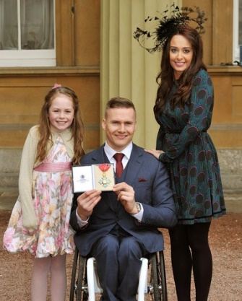
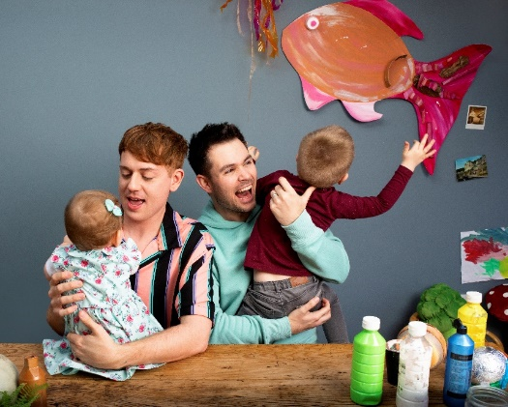
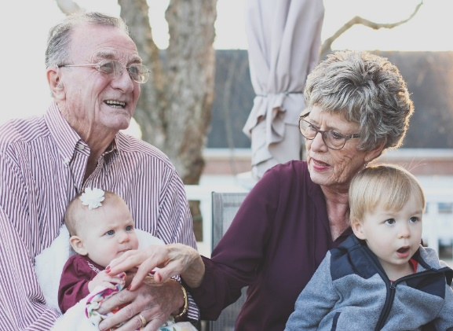
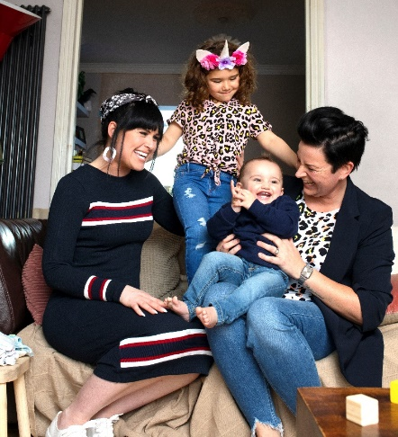
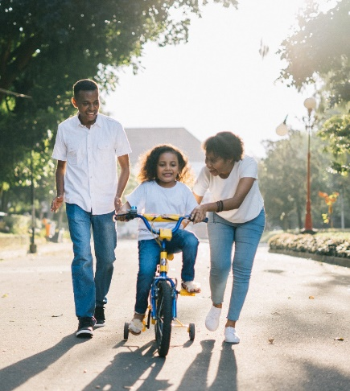
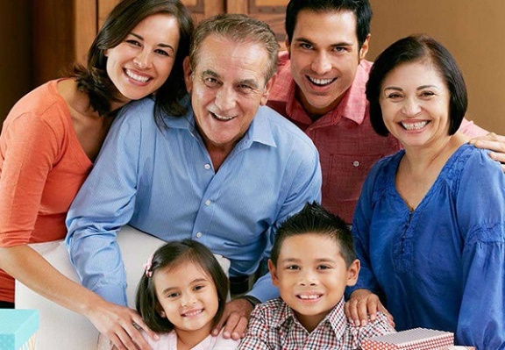
LO: To be able to share my opinions about the importance of family
Notes:
What do all of these photos have in common? They show families
How are these families different to each other? Discuss the different types of family, including families with same gender parents, foster families, adoptive families (for example, Angelina Jolie’s family (see top left).
How are these families similar?

Slide 3
LO: To be able to share my opinions about the importance of family
What do all families have in common with each other?
What does a family need?
Notes:
Ask: What do families have in common with each other?
Think. Pair. Share.
Ask: What does a family need?
Think. Pair. Share.
Make sure you have discussed healthy family relationships – love, caring, support etc.

Slide 4
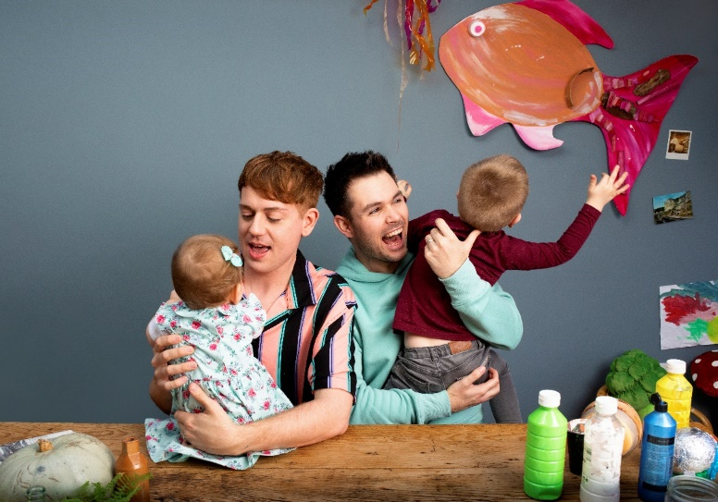
LO: To be able to share my opinions about the importance of family
Make a poster:
What does family mean to you?
Your poster needs to:
Include key words and phrases that answer the question
Show different types of family
Notes:
Ask children: What does family mean to you?
Children work in pairs or threes to make a poster about families. They should include some key words and phrases that show what family means to them (for example: love, togetherness, care, belonging). Their pictures should show different types of family.

Slide 5
LO: To be able to share my opinions about the importance of family
What does family mean to us?
Notes:
Visit a word cloud generation website, for example: www.wordclousds.com
Each child chooses a word from their poster and contributes it to the class word cloud. Add the words to the class word cloud.
Can children spot a common theme? Which words seemed most important to the class? Why might that be?

