Slide 1
PowerPoint template to accompany the LGBT+ History Month 2021 lesson pack for:
KS3 – England and Wales
S1 to S3 – Scotland
We know that good teaching is tailored to meet the needs of the children or young people in each individual class. That’s why we’ve created this editable PowerPoint template – feel free to adapt it to suit your teaching context or to add your school or college slide template to the background.
Who are Stonewall?
This resource is produced by Stonewall, a UK-based charity that stands for the freedom, equity and potential of all lesbian, gay, bi, trans, queer, questioning and ace (LGBTQ+) people. At Stonewall, we imagine a world where LGBTQ+ people everywhere can live our lives to the full. Founded in London in 1989, we now work in each nation of the UK and have established partnerships across the globe. Over the last three decades, we have created transformative change in the lives of LGBTQ+ people in the UK, helping win equal rights around marriage, having children and inclusive education.
Our campaigns drive positive change for our communities, and our sustained change and empowerment programmes ensure that LGBTQ+ people can thrive throughout our lives. We make sure that the world hears and learns from our communities, and our work is grounded in evidence and expertise.
Stonewall is proud to provide information, support and guidance on LGBTQ+ inclusion; working towards a world where we’re all free to be. This does not constitute legal advice, and is not intended to be a substitute for legal counsel on any subject matter. To find out more about our work, visit us at www.stonewall.org.uk.
Registered Charity No 1101255 (England and Wales) and SC039681 (Scotland)
Notes:
Visit our website for the lesson plan to accompany this PowerPoint.

Slide 2
LO: To use and evaluate a range of historical research methods
What is courage?
Notes:
Ask the students: What is courage?
Give them 2 minutes to discuss the idea of courage in pairs and write anything they associate with courage on a whiteboard.
Share students’ definitions of courage as a class. Ensure that they understand that courage comes in all sorts of different ways and that courage can be linked to time and place – what was courageous in the past might not seem so courageous now, because society has changed.

Slide 3
LO: To use and evaluate a range of historical research methods
What does good research look like?
Notes:
Share the LO. Explain that today the students are going to be researching a courageous woman, using a range of research methods.
Explain that the students are can use their choice of evidence type to research their person, but they need to choose at least 3 types from:
Photos and artefacts
Newspaper articles
Websites
Video
Fact files
As a class, develop the success criteria for the lesson.
If students are using online research materials, please use the websites and videos recommended in the research pack to ensure that the content they are accessing is appropriate. Always remind students of safe internet use.

Slide 4
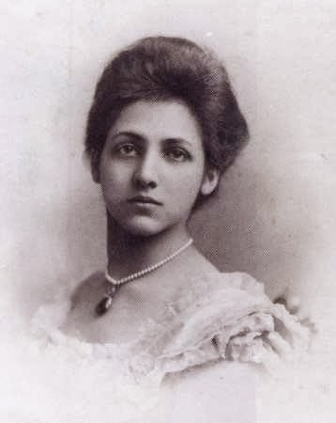
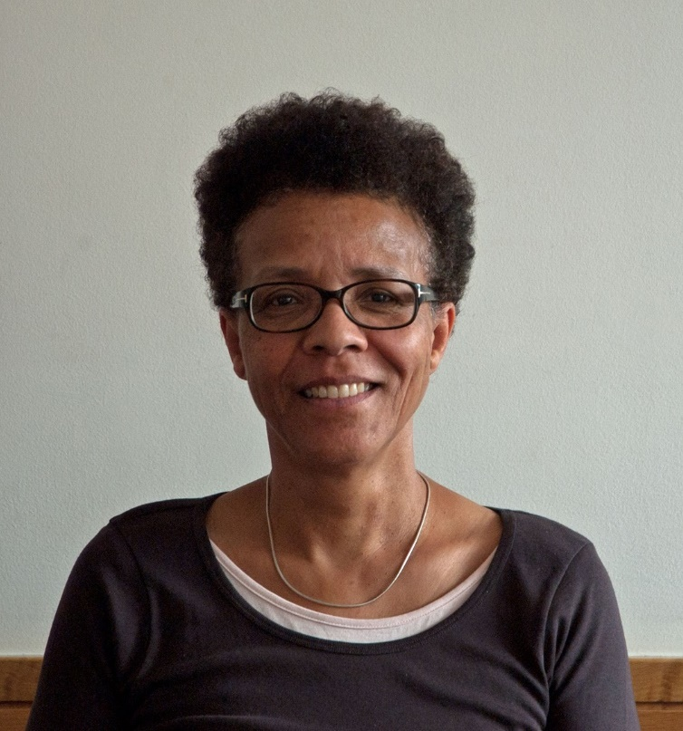
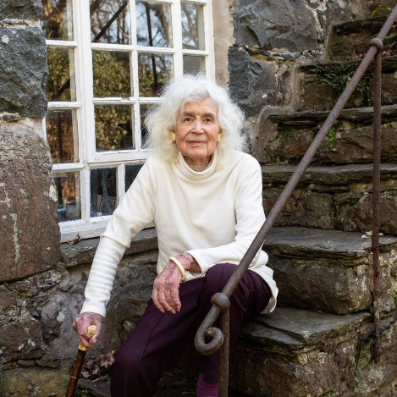
LO: To use and evaluate a range of historical research methods
Present your findings
Who is/was she?
What is/was courageous about her?
Which aspects of her life would be different if the events happened in 2021?
Notes:
Students use the fact files and ‘evidence packs’ to research one of the five courageous women.
They should present their findings however they see fit, but some options could include:
A social media profile
A poster
A PowerPoint presentation
A page for a reference book on courageous women
A one minute video
Their work should answer the following:
Who was/is she?
What did she do that was courageous?
What were some of the main events in her life?
Are there any aspects of her life that would have been different if those events had happened in 2021 instead of when they did?

Slide 5
LO: To use and evaluate a range of historical research methods
Peer assessment: Did they answer the key questions?
Notes:
Students pair up with someone that had researched a different woman to them and present the findings of their research.
Peer assessment: Has your partner answered the key questions?

Slide 6
LO: To use and evaluate a range of historical research methods
What were the benefits and pitfalls of each type of research method?
Notes:
Self assessment: Students write a short paragraph in their books: What are the pitfalls and benefits of each type of research method?

