Slide 1
PowerPoint template to accompany the LGBT+ History Month 2021 lesson pack for:
KS4 – England and Wales
S5 to S6 – Scotland
We know that good teaching is tailored to meet the needs of the children or young people in each individual class. That’s why we’ve created this editable PowerPoint template – feel free to adapt it to suit your teaching context or to add your school or college slide template to the background.
Who are Stonewall?
This resource is produced by Stonewall, a UK-based charity that stands for the freedom, equity and potential of all lesbian, gay, bi, trans, queer, questioning and ace (LGBTQ+) people. At Stonewall, we imagine a world where LGBTQ+ people everywhere can live our lives to the full. Founded in London in 1989, we now work in each nation of the UK and have established partnerships across the globe. Over the last three decades, we have created transformative change in the lives of LGBTQ+ people in the UK, helping win equal rights around marriage, having children and inclusive education.
Our campaigns drive positive change for our communities, and our sustained change and empowerment programmes ensure that LGBTQ+ people can thrive throughout our lives. We make sure that the world hears and learns from our communities, and our work is grounded in evidence and expertise.
Stonewall is proud to provide information, support and guidance on LGBTQ+ inclusion; working towards a world where we’re all free to be. This does not constitute legal advice, and is not intended to be a substitute for legal counsel on any subject matter. To find out more about our work, visit us at www.stonewall.org.uk.
Registered Charity No 1101255 (England and Wales) and SC039681 (Scotland)
Notes:
Visit our website for the lesson plan to accompany this PowerPoint.

Slide 2
LO: To understand the role key figures have played in improving attitudes to equality in the UK
2 minute challenge
Women involved in improving attitudes to equality:
name as many as you can
Notes:
Share the LO.
Challenge the students to name as many women involved in improving attitudes to equality as they can. Give them 2 minutes to complete the challenge.
Share some of the names as a class. Did the women belong to particular movements? How many women of colour did they name? How many disabled women did they name? How many of the women were LGBT?
If some women weren’t represented, why might that be? Discuss the impact racism, ableism, homophobia, biphobia and transphobia has on whose voices are heard within history and within society?

Slide 3
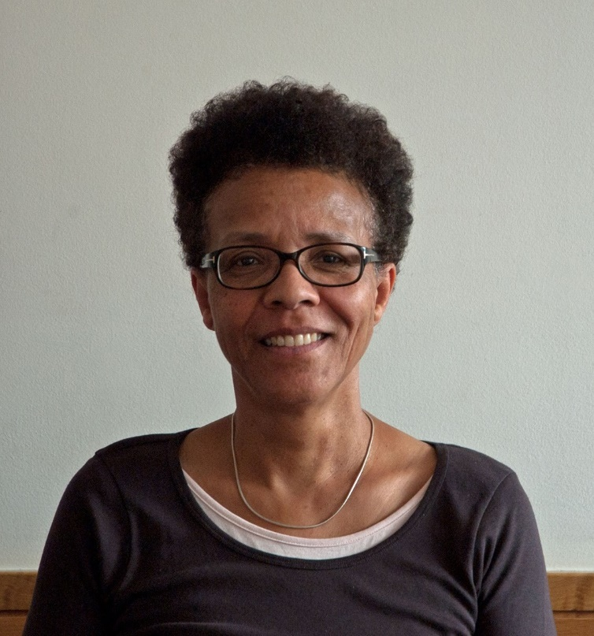
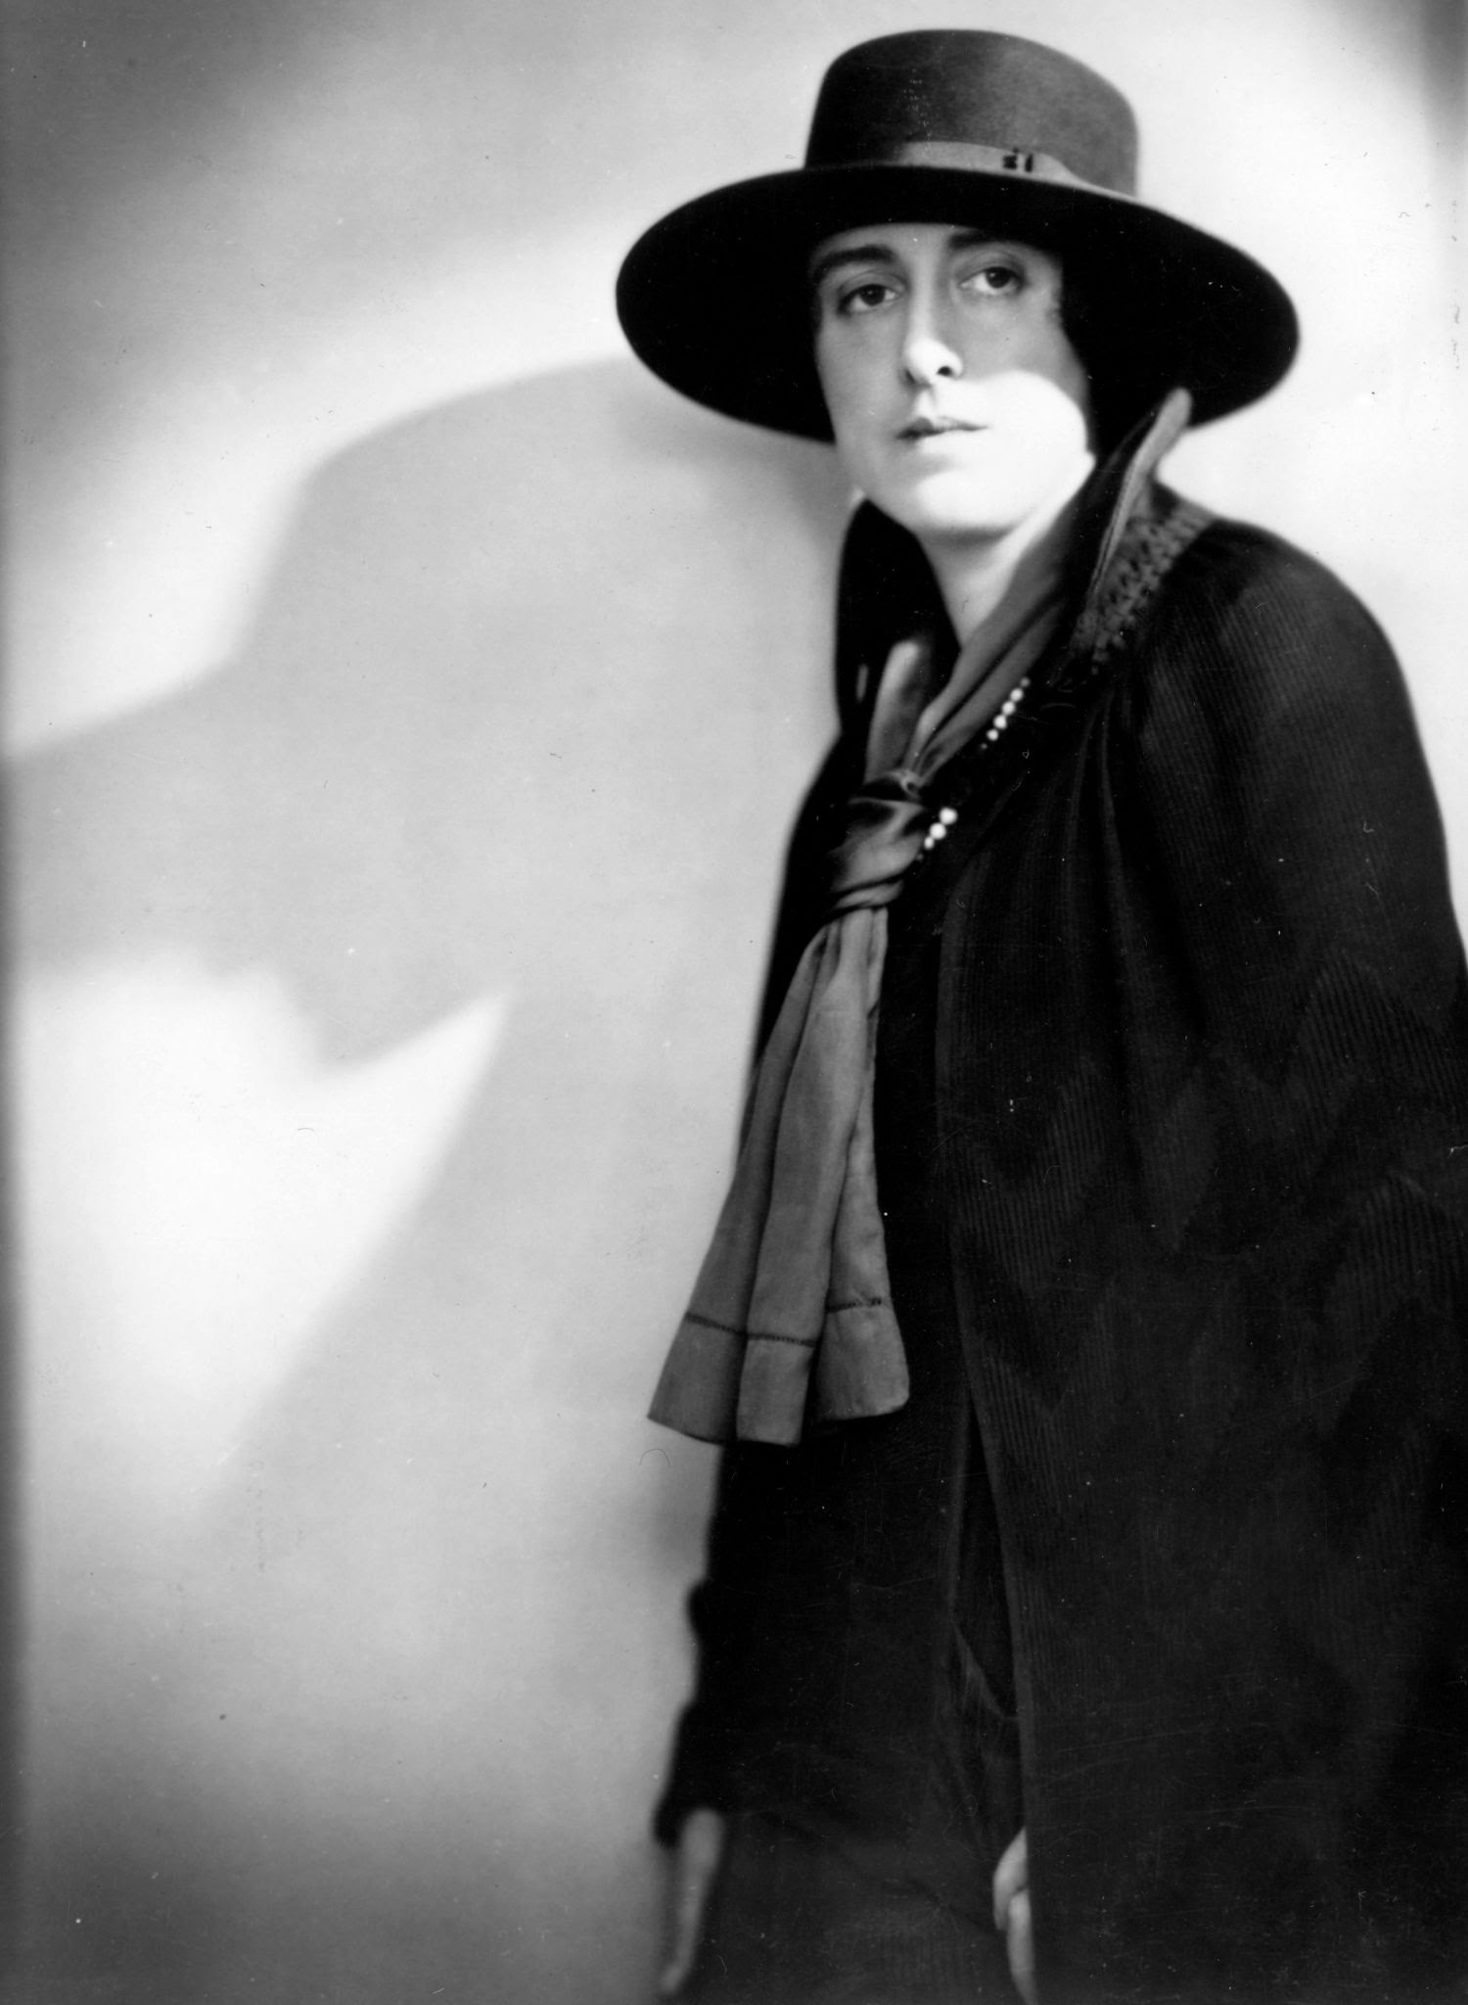
LO: To understand the role key figures have played in improving attitudes to equality in the UK
Gail Lewis
Catherine Duleep Singh
Jan Morris
Vita Sackville-West
What impact did this woman have on society and how did she bring about social change?
Notes:
Introduce the 5 inspirational LGBT women. Students should choose a woman to research. Refer back to the LO and agree the success criteria.
They should use a range of research methods to answer the question: What impact did this woman have on society and how did she bring about social change?
Students should use the fact files and ‘evidence pack’ provided, plus any additional resources you identity, to complete their research. They should ensure that they have used at least 3 different types of evidence.
They should present their answer however they see fit, but some options could include:
A social media profile
A poster
A PowerPoint presentation
A page for a reference book
A one minute video
A newspaper article
If students are using online research materials, please use the websites and videos recommended in the research pack to ensure that the content they are accessing is appropriate. Always remind students of safe internet use.

Slide 4
LO: To understand the role key figures have played in improving attitudes to equality in the UK
Peer assessment: Did they answer the question?
Notes:
Students pair up with someone that had researched a different woman to them and present the findings of their research.
Peer assessment: Has your partner answered the question? What important points did they make? Could they have added any information?

