Slide 1
PowerPoint template to accompany the LGBT+ History Month 2021 lesson pack for:
Learners with SEND/ALN/ASN
We know that good teaching is tailored to meet the needs of the children or young people in each individual class. That’s why we’ve created this editable PowerPoint template – feel free to adapt it to suit your teaching context or to add your school or college slide template to the background.
Who are Stonewall?
This resource is produced by Stonewall, a UK-based charity that stands for the freedom, equity and potential of all lesbian, gay, bi, trans, queer, questioning and ace (LGBTQ+) people. At Stonewall, we imagine a world where LGBTQ+ people everywhere can live our lives to the full. Founded in London in 1989, we now work in each nation of the UK and have established partnerships across the globe. Over the last three decades, we have created transformative change in the lives of LGBTQ+ people in the UK, helping win equal rights around marriage, having children and inclusive education.
Our campaigns drive positive change for our communities, and our sustained change and empowerment programmes ensure that LGBTQ+ people can thrive throughout our lives. We make sure that the world hears and learns from our communities, and our work is grounded in evidence and expertise.
Stonewall is proud to provide information, support and guidance on LGBTQ+ inclusion; working towards a world where we’re all free to be. This does not constitute legal advice, and is not intended to be a substitute for legal counsel on any subject matter. To find out more about our work, visit us at www.stonewall.org.uk.
Registered Charity No 1101255 (England and Wales) and SC039681 (Scotland)
Notes:
Visit our website for the lesson plan to accompany this PowerPoint or for the simpler, Widgit symbol supported version of this PowerPoint (Version 2).

Slide 2
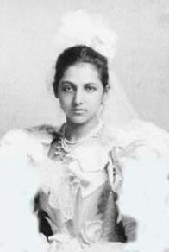
Catherine Duleep Singh
Notes:
Explain to students that they’re going to be learning about a woman named Catherine Duleep Singh that lived a long time ago.
Put all of the artefacts into different coloured bags or boxes. Give each student the chance to open one of the bags or boxes and explore the artefact. They should then show it to the rest of the group. For each artefact, click on the corresponding photo on the PowerPoint. Talk about the event from Catherine’s life related to the artefact before returning to the main page of the PowerPoint.

Slide 3
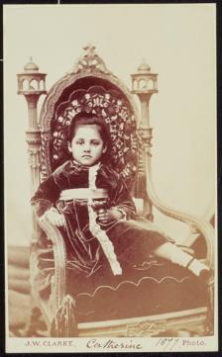
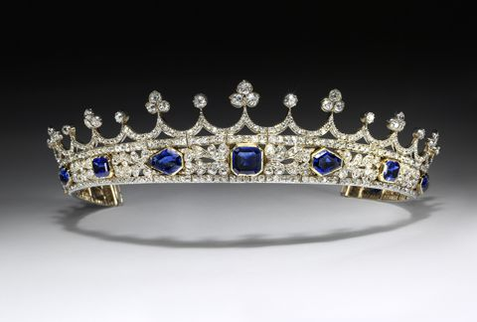
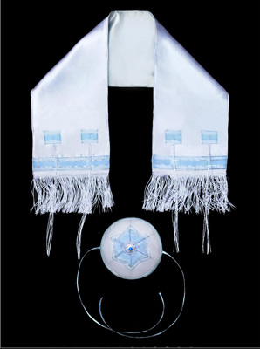
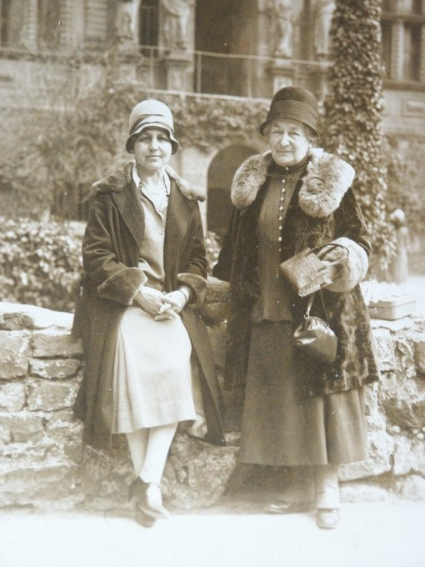
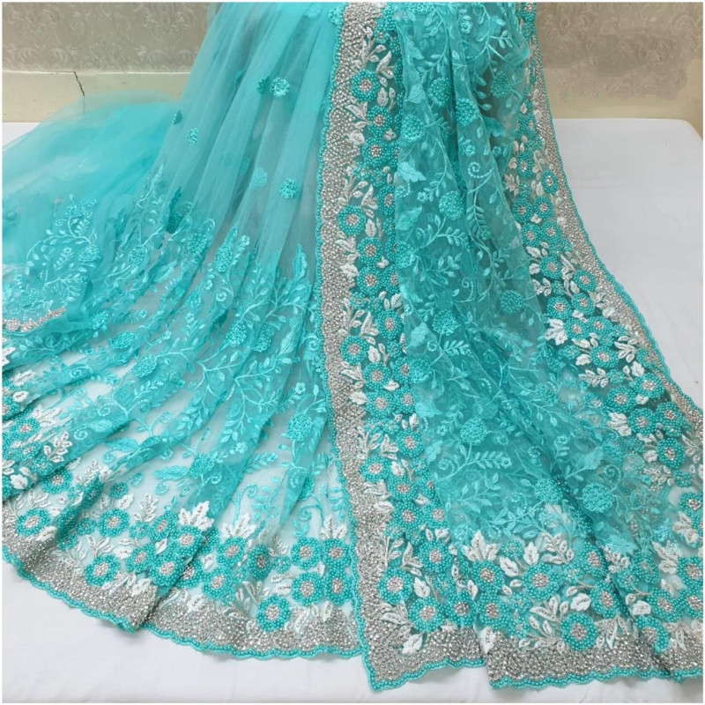
Click on the picture to find out more about Catherine.
Notes:
Explain to students that they’re going to be learning about a woman named Catherine Duleep Singh that lived a long time ago.
Put all of the artefacts into different coloured bags or boxes. Give each student the chance to open one of the bags or boxes and explore the artefact. They should then show it to the rest of the group. For each artefact, click on the corresponding photo on the PowerPoint. Talk about the event from Catherine’s life related to the artefact before returning to the main page of the PowerPoint.

Slide 4
Catherine Duleep Singh was born on 27th October 1871.
She lived in a big house in England. It was like a palace.
Back
Notes:
Click ‘back’ to return to the picture menu.

Slide 5
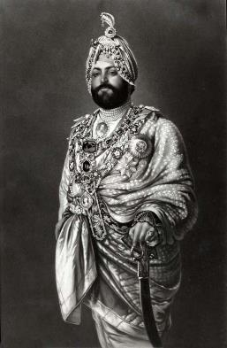
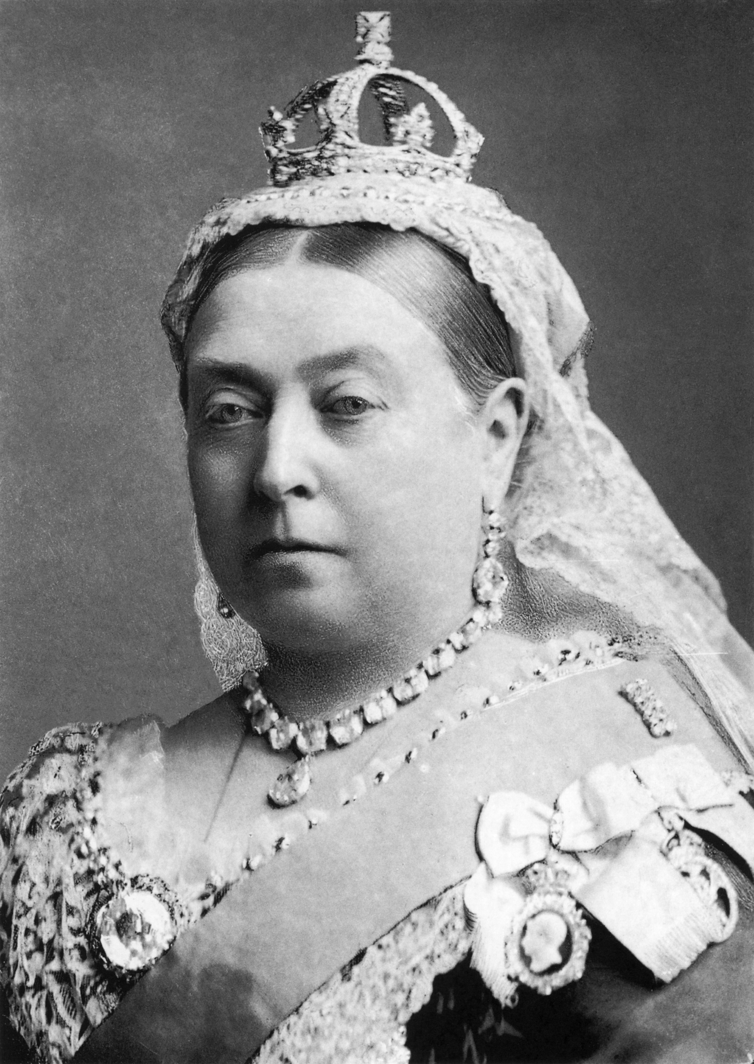
Catherine’s dad had been a member of a royal family in India.
He was friends with Queen Victoria.
Back
Notes:
Click ‘back’ to return to the picture menu.

Slide 6
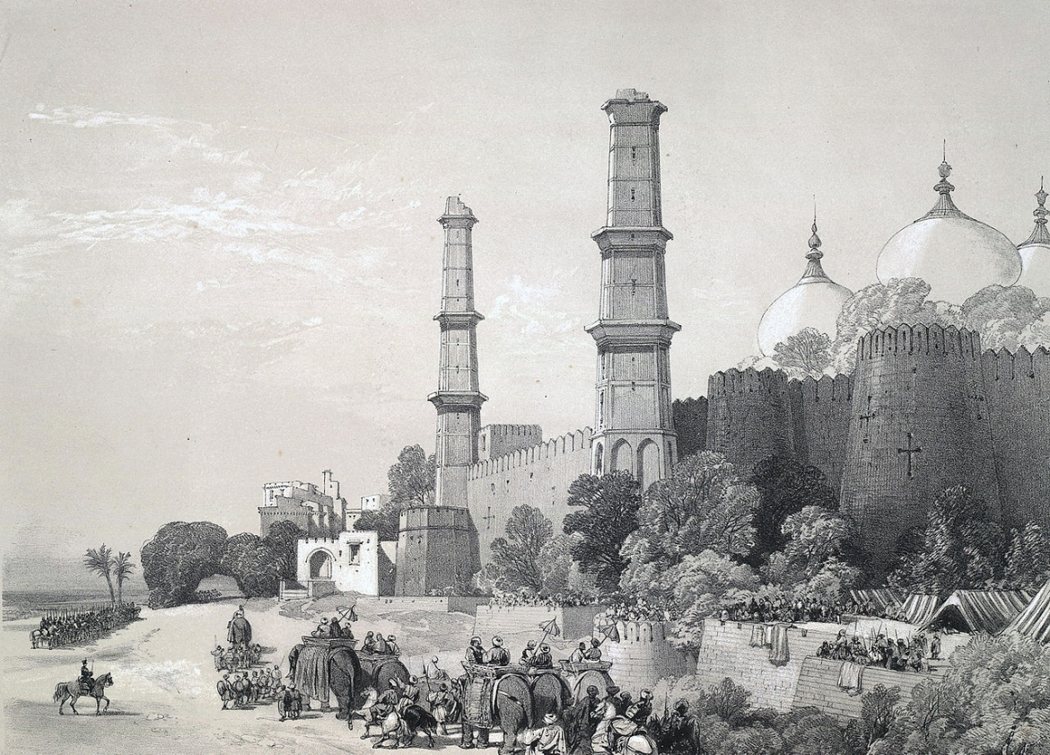
Catherine’s dad was from India.
Catherine went to visit India and she met all sorts of different people. Some of the people were rich, like Catherine. Some of the people had less money.
Back
Notes:
Click ‘back’ to return to the picture menu.

Slide 7
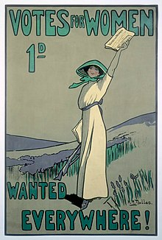
In the past, women
were not treated fairly. They were not allowed to vote.
Catherine knew that this was wrong. She joined in with other women to ask to be treated the same as men.
Back
Notes:
Click ‘back’ to return to the picture menu.

Slide 8
Catherine’s partner was
a woman called Lina.
People were sometimes unkind to Catherine because she was a lesbian. They were sometimes also unkind because she had brown skin.
Back
Notes:
Click ‘back’ to return to the picture menu.

Slide 9
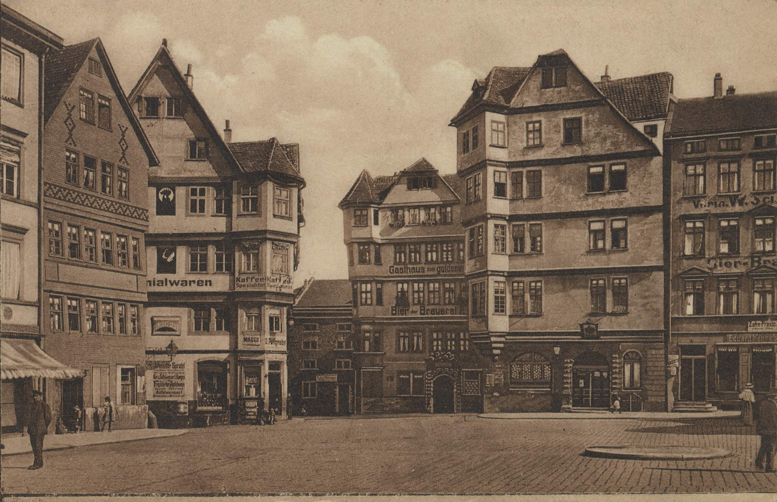
Catherine and her partner Lina lived in Germany.
They lived in a big house in a town called Kassel.
Back
Notes:
Click ‘back’ to return to the picture menu.

Slide 10
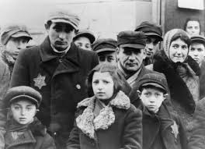
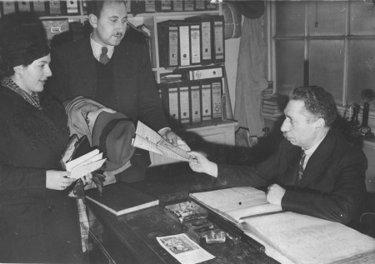
It was dangerous for Jewish people to live in Germany in the 1930s.
They were treated very badly by the people in charge.
Catherine helped some Jewish families to escape from Germany. She helped them move to live in England.
Back
Notes:
Click ‘back’ to return to the picture menu.

