Slide 1
PowerPoint template for the 2019 Anti-Bullying Week Assembly for:
Secondary aged students
We know that good teaching is tailored to meet the needs of the children or young people in each individual class. That’s why we’ve created this editable PowerPoint template – feel free to adapt it to suit your teaching context or to add your school or college slide template to the background.
Who are Stonewall?
This resource is produced by Stonewall, a UK-based charity that stands for the freedom, equity and potential of all lesbian, gay, bi, trans, queer, questioning and ace (LGBTQ+) people. At Stonewall, we imagine a world where LGBTQ+ people everywhere can live our lives to the full. Founded in London in 1989, we now work in each nation of the UK and have established partnerships across the globe. Over the last three decades, we have created transformative change in the lives of LGBTQ+ people in the UK, helping win equal rights around marriage, having children and inclusive education.
Our campaigns drive positive change for our communities, and our sustained change and empowerment programmes ensure that LGBTQ+ people can thrive throughout our lives. We make sure that the world hears and learns from our communities, and our work is grounded in evidence and expertise.
Stonewall is proud to provide information, support and guidance on LGBTQ+ inclusion; working towards a world where we’re all free to be. This does not constitute legal advice, and is not intended to be a substitute for legal counsel on any subject matter. To find out more about our work, visit us at www.stonewall.org.uk.
Registered Charity No 1101255 (England and Wales) and SC039681 (Scotland)
Notes:
Other versions of this assembly are available on the Stonewall website: www.stonewall.org.uk

Slide 2
You need to calm down…
Notes:
Watch the ‘You Need to Calm Down’ video by Taylor Swift: https://www.youtube.com/watch?v=Dkk9gvTmCXY
Encourage students to listen to the lyrics and reflect on what the song is about.

Slide 3
What is the message of the song?
“Sunshine on the street at the parade, but you would rather be in the dark ages.”
“You are somebody that I don’t know, but you’re coming at my friends like a missile.”
“Control the urges to scream about all the people you hate.”
Notes:
Talk about the lyrics of the song: “You are somebody that I don’t know but you’re coming at my friends like a missile”, “sunshine on the street at the parade, but you would rather be in the dark ages”, “control the urges to scream about all the people you hate”
Discuss that Taylor is calling out homophobia, biphobia and transphobia – both online and in person.
Discuss that one criticism of the video has been that homophobes, biphobes and transphobes are portrayed as being a certain type of person – lots of different people from different walks of life might be homophobic, biphobic or transphobic at some point. Lots of different people from different walks of life might be a good LGBT ally or LGBT themselves – don’t make assumptions but do challenge HBT bullying.

Slide 4
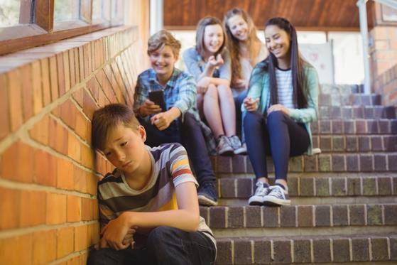
The Stonewall School Report (2017) found that…
Nearly half of LGBT young people are bullied for being LGBT
Half of LGBT pupils hear homophobic slurs ‘frequently’ or ‘often’ at school
Notes:
Share the quote from the school report. How might it feel to be bullied for being LGBT?

Slide 5
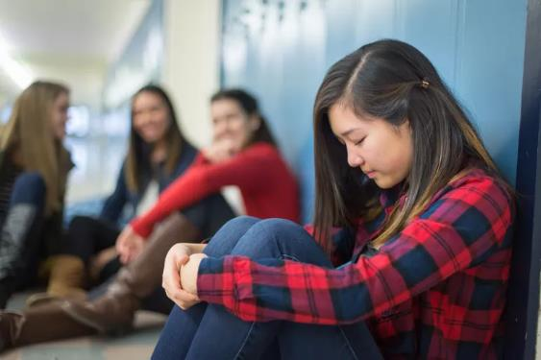
How would it feel?
“I felt like whatever I was doing was worthless. Even if I did well in school, it wouldn’t matter to people because all they would care about is me being gay.”
ZOE, 12, SECONDARY SCHOOL Student
Notes:
Share the quote from the school report. How might it feel to be bullied for being LGBT?

Slide 6
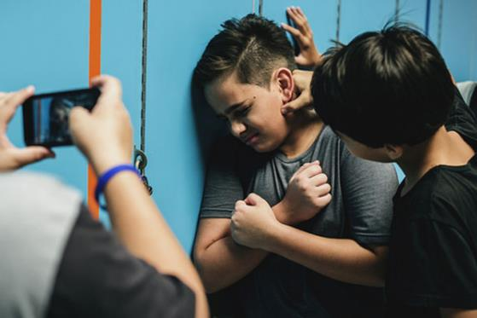
How would it feel?
“After coming out to the people around me, I was taunted a lot with people using my preferred name like it was a
curse word.”
Elliott, 12, SECONDARY SCHOOL Student
Notes:
Share the quote from the school report. How might it feel to be bullied for being LGBT?

Slide 7
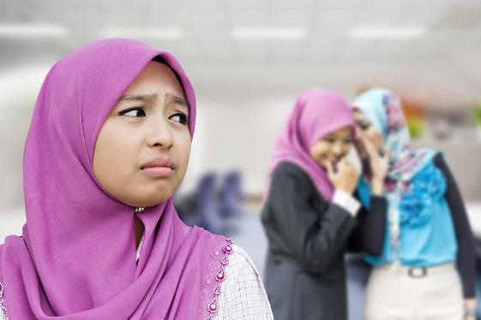
How would it feel?
I’ve been shouted at and talked about on multiple occasions because of my sexuality and I’ve heard remarks such as ‘bisexuals are more likely to cheat, I’d never date a bi woman or man’.
SIAN, 13, SECONDARY SCHOOL Student
Notes:
Share the quote from the school report. How might it feel to be bullied for being LGBT?

Slide 8
Notes:
Explain that it is anti-bullying week and the theme is “Change Starts With Us”. This year the goal is to inform schools and settings, children and young people, parents and carers to know that it takes a collective responsibility to stop bullying. Bullying is usually defined as repeated behavior which is intended to hurt someone either emotionally or physically.
Ask students to reflect on homophobia, biphobia and transphobia in particular.

Slide 9
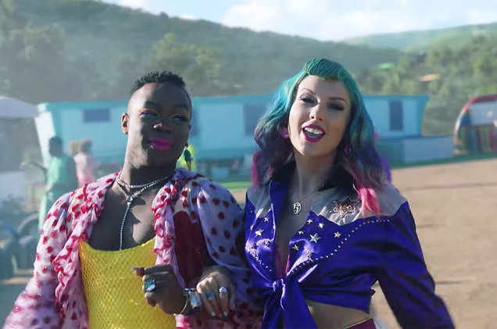
Be an LGBT ally!
Challenge bullying when you see it.
Learn more about LGBT people’s experiences.
Speak up for LGBT people.
Notes:
Encourage students to be an ally to LGBT people. Ask: What is an ally? Discuss that an ally speaks up for others, challenges mistreatment of others etc.

Slide 10
PAUSE
Notes:
Pause for thought. Encourage the students to take a moment to reflect on how they can tackle homophobic, biphobic and transphobic bullying.

Slide 11
Be an LGBT ally!
What will you do?
Notes:
Choose some students to share what they are going to do to challenge homophobia, biphobia and transphobia and to be an LGBT ally
Encourage students to call out bullying when they see it, to report it, to support their friends to report it and just be kind!

